Slide 2
Cryptography 101 with .NET Core
Robert Boedigheimer

Slide 3
About Me
Microsoft MVP – Developer Technologies
ASPInsiders
Pluralsight Author
Progress Developer Expert – Fiddler
3rd Degree Black Belt, Tae Kwon Do
@boedie

Slide 4
Background
Cryptography is the science of keeping messages secure
Why Cryptography?
Confidentiality – protect data from being read
Integrity – verify that data was not modified
Authentication – identify and validate a user
Non-repudiation – sender cannot deny later that he sent a message
System.Security.Cryptography
Don’t write own!!

Slide 5
Hashing

Slide 6
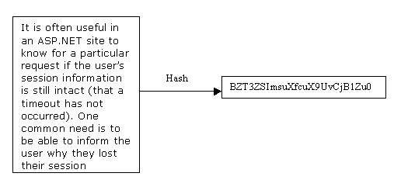
Hash Functions
One-way function – easy to compute but significantly harder to reverse
Hash function – converts a variable length input to a fixed length
Creates a “data fingerprint” (digest)
Ok to see, don’t let it be tampered with (Integrity)

Slide 7
Demo Hash Functions

Slide 8
Encryption and Decryption

Slide 9
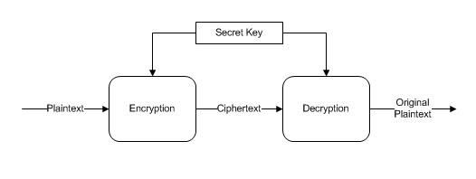
Symmetric Algorithms
Encryption and decryption use the same (secret) key
Primary attack is “brute force” key search, try all possible keys
Key distribution is difficult
Abstract class SymmetricAlgorithm
AES
TripleDES
Notes:
FIPS-197 specifies that the block size must always be 128 bits in AES, and that the key size may be either 128, 192, or 256 bits (Rijndael allows more choices)
Rijndael is a family of ciphers with different key and block sizes (class not in .NET Core)

Slide 10
Symmetric Algorithms (cont.)
.NET symmetric algorithms are “block ciphers”
Mode
ECB
CBC (recommend)
IV (Initialization Vector)
Random data used to seed first block
Does not need to be secret
Never reuse, always unique for each set of data!
Notes:
http://en.wikipedia.org/wiki/Block_cipher_modes_of_operation
ECB – each block encrypted on its own
CBC – uses encrypted data from first block as input into the next block’s encryption

Slide 11
Demo Symmetric Algorithms

Slide 12
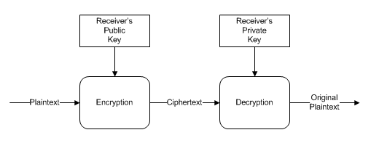
Asymmetric Algorithms
Utilizes two complimentary keys (public key and private key)
Generally 1,000 times slower than symmetric algorithms
Often use asymmetric to encrypt a “session” symmetric key
Abstract class AsymmetricAlgorithm
RSA
DSA (digital signatures only)
ECDiffieHellman

Slide 13
Demo Asymmetric Algorithms

Slide 14
Digital Signatures

Slide 15
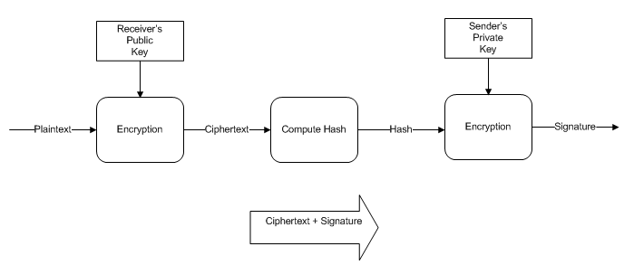
Digital Signatures
Provides integrity and non-repudiation
Hash the contents of a message, sign it (encrypt) with senders private key
By default, does not provide confidentiality, can encrypt with receivers public key before signing

Slide 16
.NET Core 3.0

Slide 17
.NET Core 3.0
Authenticated Encryption
Combines encryption and a MAC (hash)
Ensures ciphertext was not tampered with
System.Security.Cryptography
AesGcm
AesCcm
Expanded Cryptographic Key Import/Export
Notes:
https://tinyurl.com/o2zgbjk - https://technet.microsoft.com/en-us/office/0ss79b2x(v=vs.99) under “Choosing an Algorithm”

Slide 18
Summary

Slide 19
Summary
Don’t write own!
Use trusted algorithms and implementations
Use hashing to validate the integrity of data or to prove both know the same secret
Use symmetric algorithms unless special needs for asymmetric (digital signatures, key exchange, etc.)
Know threats, choose the proper countermeasures
Notes:
https://tinyurl.com/o2zgbjk - https://technet.microsoft.com/en-us/office/0ss79b2x(v=vs.99) under “Choosing an Algorithm”

Slide 20
Resources
Pluralsight – Introduction to Cryptography in .NET
https://tinyurl.com/kkn3coq
Serious Cryptography – Jean-Philippe Aumasson
Applied Cryptography - Bruce Schneier
Cryptography Engineering – Ferguson, Schneier, Kohno
Understanding Cryptography – Paar, Pelzl
The Code Book – Simon Singh
The Code-Breakers – Kahn
Notes:
https://tinyurl.com/o2zgbjk - https://technet.microsoft.com/en-us/office/0ss79b2x(v=vs.99) under “Choosing an Algorithm”

Slide 21
Questions
@boedie
dotnetconf@boedie.dev
Slides and code - https://tinyurl.com/y3jzbq2m

